Slide 1
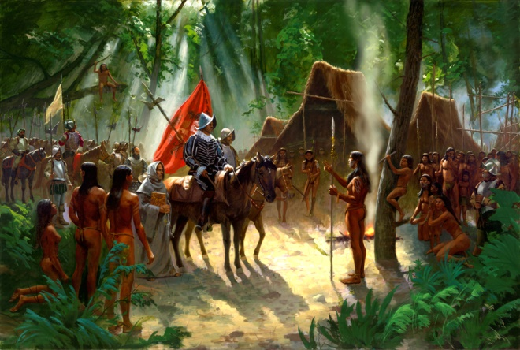
Native Americans in
Missouri

Slide 2
As early as the last Ice Age, there have been humans in the area that we now call Missouri.
The “Early Hunter” period of civilization is considered from 12,000 to 8,000 B.C.
Flintlike spears, similar to those found at Clovis, New Mexico have been discovered at Mastodon State Park south of St. Louis. This gives credence to the idea that the Clovis culture (believed to be the earliest culture in North America) had entered the central part of the continent.

Slide 3
The “Archaic” period was the next period of civilizations in the area, from 8,000 to 500 B.C.
These hunter-gatherers dwelt in caves in Missouri and stayed in areas longer than the nomadic Early Hunters.
Graham Cave in Montgomery County was home to some of these peoples. Others lived in the lowland areas of southeastern Missouri.

Slide 4
We must remember that there is no clear cut chronological dividing points for any of these periods. The Early Hunters transitioned into the Archaic period and the Archaic transitioned into the Woodland Period.
The Woodland Period occurred from 1,000 B.C. to 900 A.D. It was a time of significant development of pottery. These peoples stayed even longer in one area and engaged in trade with other cultures.
The Hopewell culture developed during the Woodland Period.

Slide 5
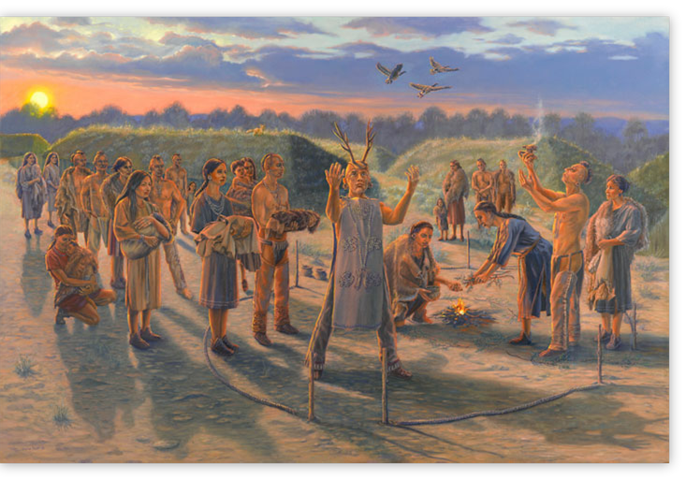
Hopewell Indians

Slide 6
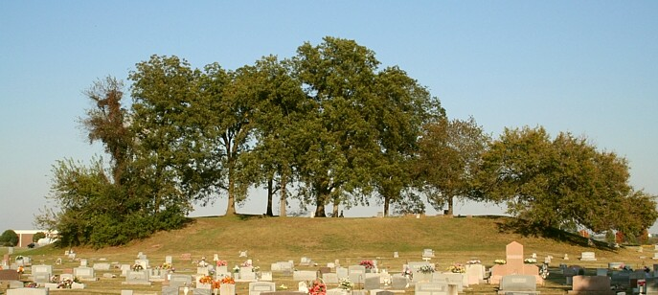
The Hopewell Indians engaged in farming, growing corn or maize. The made pottery and built large earthen mounds for celebrations and burial rites. They lived predominantly in central Missouri, in the area of the Missouri and Kansas Rivers.

Slide 7
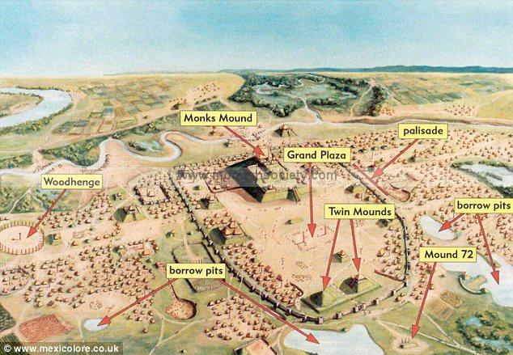
The Hopewell culture existed not only during the Woodland period but also the Mississippi period. There were four areas of Hopewell cultures in Missouri.
The Mississippi period lasted from around 900 A.D. to 1500 A.D. It was the timeframe of the development of the Cahokia culture along the Mississippi River area.

Slide 8
The Cahokia tribe grew in the area to the east of what is now St. Louis. They were part of the Mound Builders culture. While earlier cultures had built some earthen mounds, it was the Cahokia culture that has the strongest connection with this practice. The largest settlement of Mound Builders was at Cahokia and it was known as the center of their civilization.

Slide 9
Cahokians had large farms in the river valleys and traded salt, pottery, tools, and jewelry with other tribes. The established “colonies” in other locations as far west as Kansas City and south into northern Arkansas. They lived in square or rectangular wood frame dwellings covered with thatched roofs.
While deSoto’s men made mention of a thriving civilization, the Cahokians were all but gone by the time Marquette and Joliet traveled the Mississippi in 1673.

Slide 10
The Oneota Culture existed in Missouri from 1350 A.D. to 1500 A.D.
The Oneota were hunters and gardeners. They liked ornamentation and smoked tobacco. It was from the Oneota that the Missouri and the Osage tribes developed.

Slide 11
The Quapaw tribe could be found in Missouri from 1500 A.D. to 1800 A.D. They settled at the mouth of the Arkansas River.
While one tribal culture became known as the “upstream people,” the Quapaw went more south and became the “downstream people.” They continued in the practice of building large earthen mounds.
From the upstream people came the Omaha, Kansas, Ponca, and Osage.

Slide 12
During this same time period (1500-1800 A.D.) came the Missouri Indians. The Missouri, Ioway, and Oto all developed from the same culture. They came out of the Sioux culture. Other tribes derived from the Algonquin culture. They were the Fox, Sauk, Illinois, Shawnee, Kickapoo, and Delaware tribes. The Missouri and Sauk tribes were enemies. The name of the Missouri tribe came from the Fox and meant “Big Canoe people.” The Fox and the Sauk were enemies with the Missouri and pretty well wiped out the Missouri.
These tribes existed at the same time that white settlers began to enter Missouri. Several of these groups would trade with the whites.

Slide 13
Probably the most well-known tribe to be found in Missouri were the Osage Indians. They existed from around 1600 A.D. to 1830 A.D. The name “Osage” was a French abbreviated from of Wazhazhe or the “upstream people.”
The Osage trades with French traders in the region and refrained from much conflict. The Osage hunted the Ozark highlands and into the western plains. They traded furs and salt for metal weapons and tools.

Slide 14
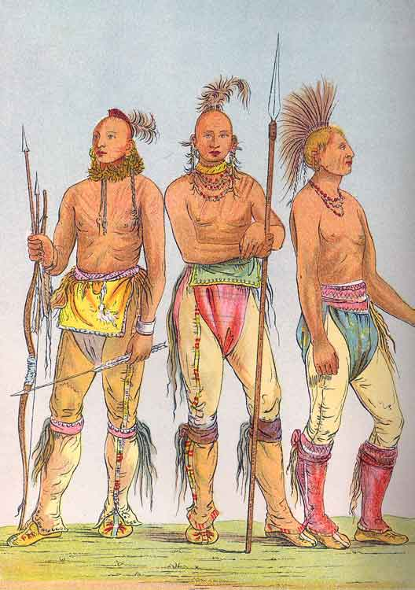
Osage warriors

Slide 15
The Osage were tall warriors, standing over six feet. They could run sixty miles in a day and possess physical strength to put an arrow through a grown buffalo. The men had bald heads except for a small knob of hair called a “scalplock.” They decorated their bodies with paint, jewelry, and piercings.
The Osage saw the Europeans as dirty and unkempt, due to the practice of growing facial hair. They called the French “groundhogs” and “heavy eyebrows.”

Slide 16
While the Osage existed with and interacted with the whites, they did not adapt to white ways. There were many social misunderstandings between the two cultures.
The early days of the 19th century, before Missouri became a state found more than 6,000 Osage living in Missouri. By 1808, they began to give up their land in region. Nearly all of the Osage were gone from Missouri and relocated to the Indian Territory of Oklahoma by 1825.

Slide 17
The focus of the whites in Missouri on gaining statehood made what Native Americans remaining in the area realize the seriousness of this situation. Armed conflict would arise between the two cultures.
In 1819 the Ioway, Fox, and Sauk tribes gave up land north of the Missouri River. They had fought the whites during the War of 1812, siding with the British. Many times these tribes would drop down into Missouri from Iowa and attack settlers. Some of these skirmishes even occurred in Adair County.

Slide 18
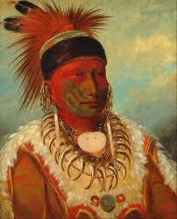
White Cloud of the Ioway

Slide 19
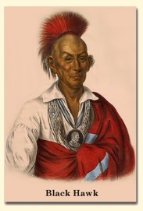
Black Hawk was a Sauk chieftain. He led his people back into their original lands in Illinois in the early 1830s only to be forced back into Iowa. These conflicts became known as the Black Hawk War. Some of Black Hawk’s braves ventured out of Iowa into Missouri and even into Adair County to attack settlers.

Slide 20
The forced relocation of the Cherokee and other tribes in the Southeast during the presidency of Andrew Jackson brought the last Native American culture to inhabit parts of Missouri.
The Trail of Tears made its way through parts of southern Missouri and a few of these Cherokee would settle along the St. Francis River and other parts of the Ozarks. There are still people living in this region who tell stories about their Cherokee ancestors.

Slide 21
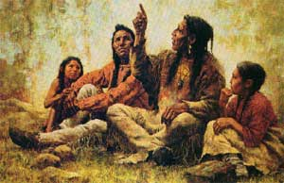
Cherokee

