Slide 1
Chapter Two Section One
Review

Slide 2
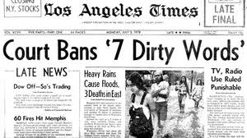
1. Judge Jones read through the court records for the case found in this headline when a radio DJ was charged with indecent language on the air. The judge was exercising his ability of using a ______________ in making his decision on the current case.
Mandate
Precedent
Compact
Continuance

Slide 3
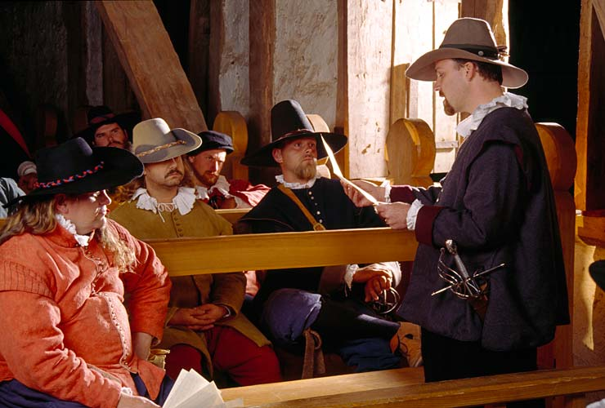
2. This image is from a recreation of the Virginia House of Burgesses. The House of Burgesses is known for being
a. open to women members b. the 1st court in America
c. open to slaves d. the 1st legislature in America

Slide 4
3. Jim, Oscar, and Salvador joined a few of their neighbors in an agreement to manage the amount of unleashed dogs in their community. Which of the following words would best represent what these individuals entered into?
Compact B. Register
C. Corporation D.Embargo

Slide 5
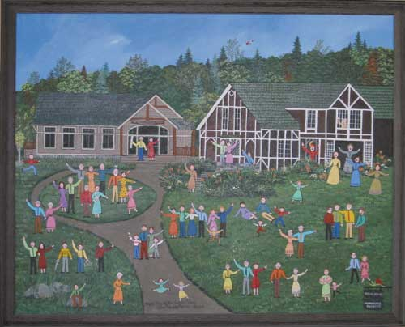
All residents of Whoville graduate from the same school.
The government of Whoville is led by a local administrator.
No one over the age of 40 is allowed to live in Whoville.
The main authority of Whoville is the king in Seussland.
4. Which of the following best relates to the term “colony?”

Slide 6
5. A group of individuals elected to create and manage the laws of the group is known as a
Biosphere
Legislature
Presidentiary
Chancellorary

Slide 7
6. The best example of “common law” would be
Everyone in the community purchases their vegetables at the Farmers’ Market.
All mothers in town sign an agreement to teach their boys how to sew.
The land-owning men in the colony vote to amend their constitution.
No one in the community mows their yard on Sundays.

Slide 8
7. Which of the following is a similarity between each of the English colonies in North America?
All legislatures are bi-cameral
The king appointed the governor of the colony
Free adult males voted for their legislative representatives
All legislatures were modeled on the English Parliament.

Slide 9
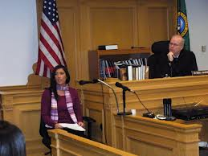
8. Which of the following established the rule that all citizens would receive a fair trial?
English Bill of Rights
Mayflower Compact
Virginia House of Burgesses
Glorious Revolution

Slide 10
Answers Ahead!

Slide 11
1. Judge Jones read through the court records for the case found in this headline when a radio DJ was charged with indecent language on the air. The judge was exercising his ability of using a ______________ in making his decision on the current case.
Mandate
Precedent
Compact
Continuance

Slide 12
2. This image is from a recreation of the Virginia House of Burgesses. The House of Burgesses is known for being
a. open to women members b. the 1st court in America
c. open to slaves d. the 1st legislature in America

Slide 13
3. Jim, Oscar, and Salvador joined a few of their neighbors in an agreement to manage the amount of unleashed dogs in their community. Which of the following words would best represent what these individuals entered into?
Compact B. Register
C. Corporation D.Embargo

Slide 14
All residents of Whoville graduate from the same school.
The government of Whoville is led by a local administrator.
No one over the age of 40 is allowed to live in Whoville.
The main authority of Whoville is the king in Seussland.
4. Which of the following best relates to the term “colony?”

Slide 15
5. A group of individuals elected to create and manage the laws of the group is known as a
Biosphere
Legislature
Presidentiary
Chancellorary

Slide 16
6. The best example of “common law” would be
Everyone in the community purchases their vegetables at the Farmers’ Market.
All mothers in town sign an agreement to teach their boys how to sew.
The land-owning men in the colony vote to amend their constitution.
No one in the community mows their yard on Sundays.

Slide 17
7. Which of the following is a similarity between each of the English colonies in North America?
All legislatures are bi-cameral
The king appointed the governor of the colony
Free adult males voted for their legislative representatives
All legislatures were modeled on the English Parliament.

Slide 18
8. Which of the following established the rule that all citizens would receive a fair trial?
English Bill of Rights
Mayflower Compact
Virginia House of Burgesses
Glorious Revolution

