Slide 1
Missouri History
Using Google Maps

Slide 2
How familiar are you with Google Maps?

Slide 3
Today we are going to use the program to create a personal map representing three battles during the Civil War in Missouri in 1861. To be able to display our postings we have to be signed into Google.

Slide 4
Okay, so let’s shift gears a bit now that we have access to Google. We all remember Marty McFly and Doc Brown hoping in that DeLorean and traveling back to the future, right? Well, let’s suppose that during the Civil War there was media coverage and meteorological service like today. Actual weather service efforts did not originate until the 1880s, but not for our purposes. Today, there is a weatherman to provide us with the forecast.

Slide 5
Missouri Central Region Forecast
Provided by
Missouri Weather Service
Serving Missouri since 1821

Slide 6
Your Missouri Weather Service Extended Forecast for June 26, 1861 through July 4, 1861. Expect hot and humid conditions through central Missouri with periods of thunderstorms throughout the region.
Wednesday, June 26th: Periods of strong thunderstorms are expected for the forecast area. Chance of precipitation 60 percent. Highs in the upper 80s, lows in the mid 70s.
Saturday, June 29: Rain chances continue. Expect showers and thunderstorms with some storms severe. Chance of precipitation 70 percent. Highs in the lower 90s, lows in the mid 70s.
Wednesday, July 3: Showers and thunderstorms likely, some storms may produce significant rainfall. Chance of precipitation 90 percent. Highs in the lower 90s, lows in the mid 70s.
For Thursday, July 4: Rain chances continue, scattered thunderstorms possible. Chance of precipitation 50 percent. Highs in the upper 80s, lows in the lower 70s.

Slide 7
Okay, so now we know what to expect from the forecast as we get ready for our Fourth of July celebrations. Unfortunate for the military groups located in the state at that time, they did not. They suffered the effects of the weather as they attempted to make their way across the state.
We are going to examine three battles that occurred in Missouri during 1861, first, the Battle of Carthage, then the Battle of Wilson’s Creek, and finally, the First Battle of Lexington commonly referred to as the Battle of the Hemp Bales.

Slide 8
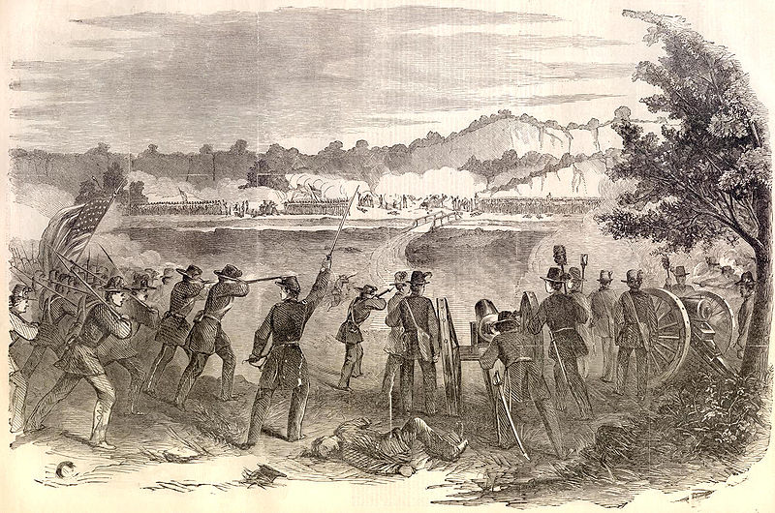
Battle of Carthage 1861: The Weather and its Impacts
Dr. Anthony R. Lupo
James Michael Madden

Slide 9
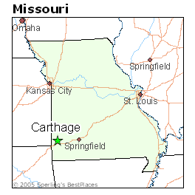
Introduction
Setting: Near Carthage, MO

Slide 10
Introduction
July 5, 1861
Union Commander: Franz Sigel
Confederate Commander: Gov. Claiborne Jackson
Estimated Casualties: 244 (US: 44 Con: 200)
Campaign: Operations to Control Missouri
“Battle had little meaning, but pro-Southern elements in Missouri championed their first victory.”
The American Battlefield Protection Program, "Carthage". The American Battlefield Protection Program. March 23, 2010 <http://www.nps.gov/history/hps/abpp//battles/mo002.htm>.

Slide 11
Quick Pre-battle Overview
Union General Nathaniel Lyon chased Confederate Governor Jackson from Jefferson City and from Boonville, and pursued them.
Col. Franz Sigel led another force of about 1,000 into southwest Missouri in search of the governor and his loyal troops.
Upon learning that Sigel had encamped at Carthage, on the night of July 4, Jackson took command of the troops with him and formulated a plan to attack the much smaller Union force.
The American Battlefield Protection Program, "Carthage". The American Battlefield Protection Program. March 23, 2010 <http://www.nps.gov/history/hps/abpp//battles/mo002.htm>.

Slide 12
Weather Roles
After Boonville victory, Lyons planned to vacate Boonville by the 26th of June; however, heavy rains and supply problems stalled efforts.
June 29th, rain continued to pour down, again pushing back Lyon’s departure.
As a result, Lyon was unable to begin his push against the State Guard (Confederates) until July 3rd.

Slide 13
Weather Roles
On the Confederate side, the retreat ran into a “blinding” thunderstorm on July 3rd when the troops united south of Lamar.
“Torrential rains wreaked havoc with every attempt to train and drill the troops… Much of the gunpowder was soaked by the rain.”
This situation created chaos for artillery and training before the conflict.

Slide 14
Weather Roles
July 4th was reported as “hot and humid”.
The temperatures across the region were in the 70s during the morning and the upper 80s and low 90s during the day.
See http://www.djburnette.com/research/kansas/index.html

Slide 15
Missouri Weather Roles Summary
These rain showers were incredibly vexing to both sides.
Due to these showers, Lyon was held back. No one on the Confederate side had a clue how far away Lyon and his experienced troops were.
These storms gave Jackson mixed signals.
Should he continue moving his army deeper into southwest Missouri to train his men, or hold his ground and prepare to make a stand against Lyon’s expected, and rumored pursuit?

Slide 16
As a Result
As Jackson moved south, the Union Sigel caught wind of his Jackson’s actions. He learned there were Confederates approaching Newton County. He hurried his men to prevent a confederate juncture which would supply the confederates with more men and artillery.
The two armies met about 12 miles from Carthage at Coon Creek and a line of battle was drawn.

Slide 17
A Miscellaneous Clue in Minnesota
Thatcher’s Comet
Orbits us every 415 years.
Spotted on June 30th in MN.
Could possibly indicate an area of high pressure.
Temperatures were cooler?

Slide 18
Putting it all Together
Clues
Moderate to Heavy Rains
Continuing for a long period of time; indicates a possible stalled front
A lot of precipitation with warm temperatures following
Cool Minnesota, with a comet

Slide 19
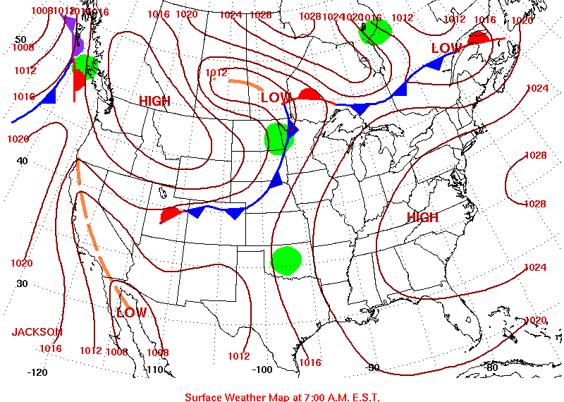
Possible Matches: June 26th – July 4th, 2007
June 26th

Slide 20
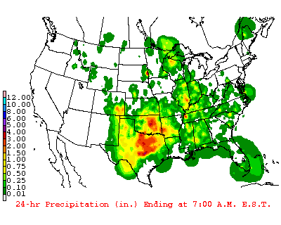
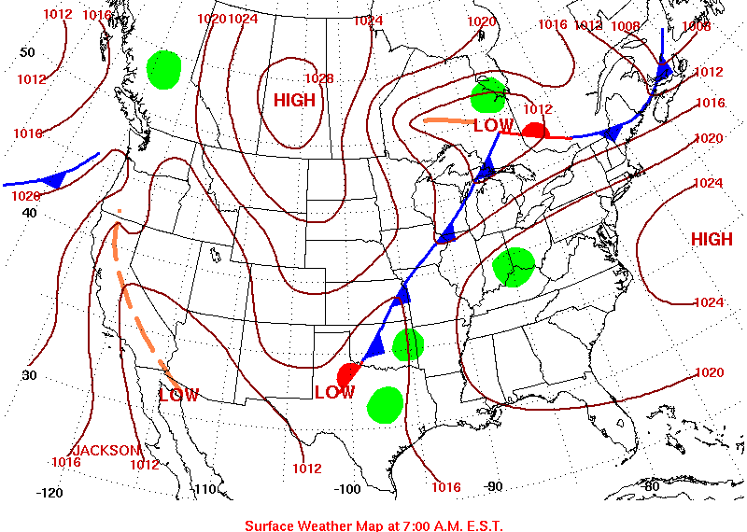
Possible Matches: June 26th – July 4th, 2007
June 27th

Slide 21
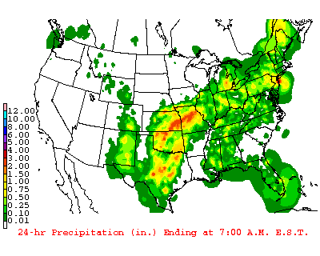
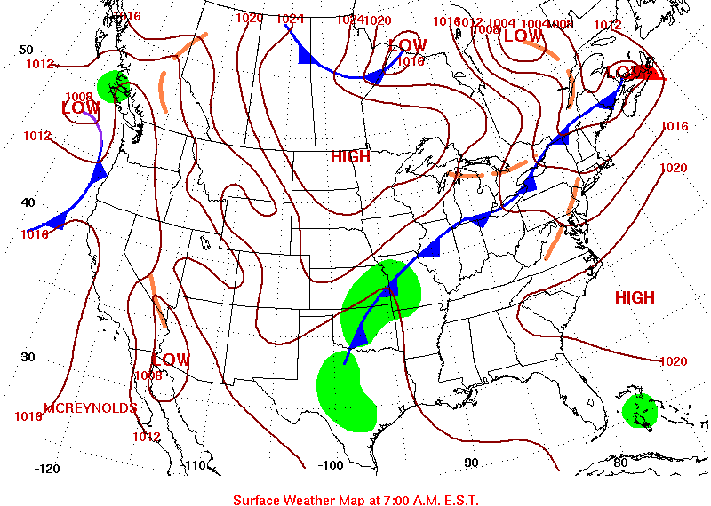
Possible Matches: June 26th – July 4th, 2007
June 28th

Slide 22
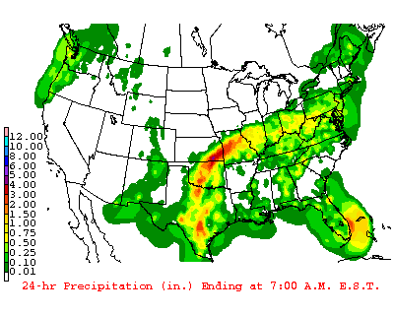
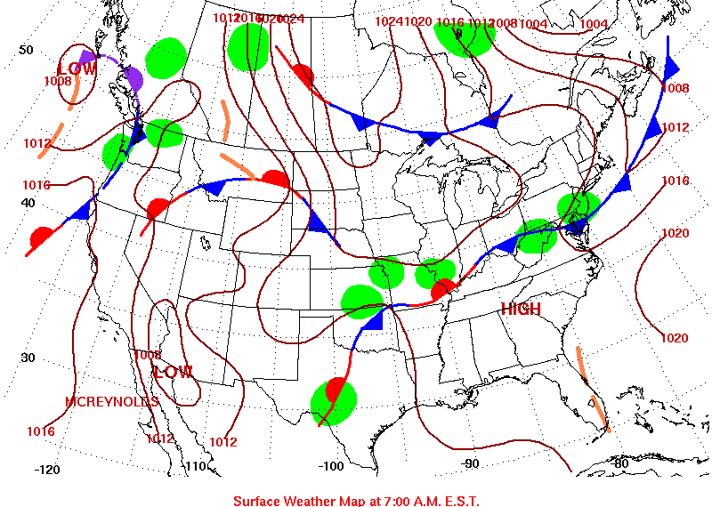
Possible Matches: June 26th – July 4th, 2007
June 29th

Slide 23
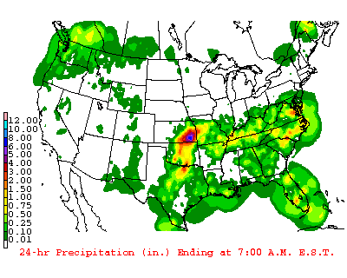
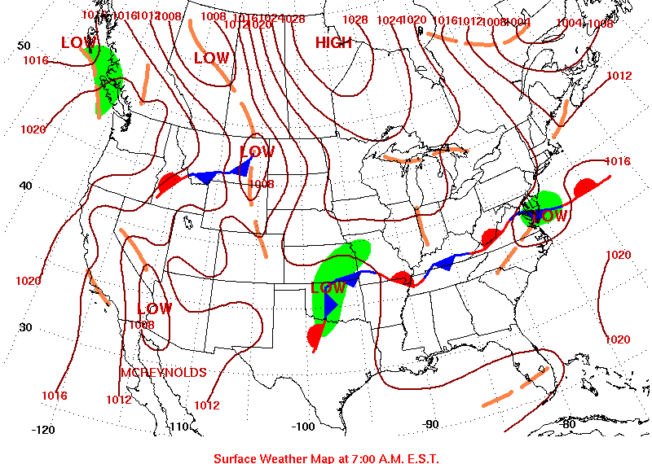
Possible Matches: June 26th – July 4th, 2007
June 30th

Slide 24
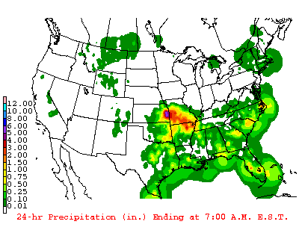
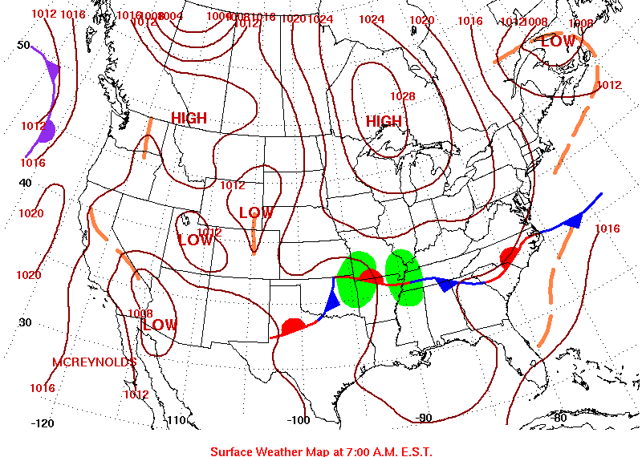
Possible Matches: June 26th – July 4th, 2007
July 1st

Slide 25
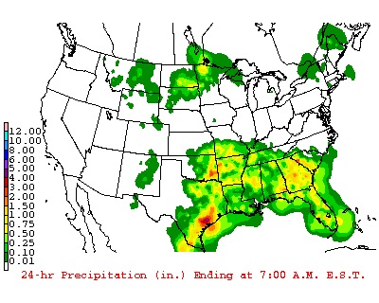
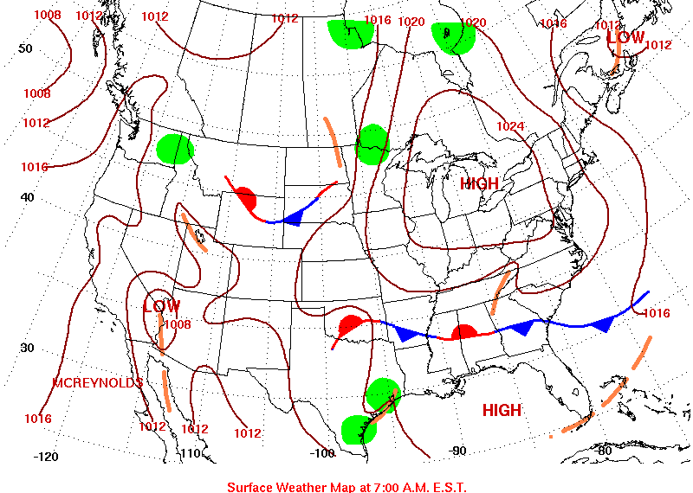
Possible Matches: June 26th – July 4th, 2007
July 2nd

Slide 26
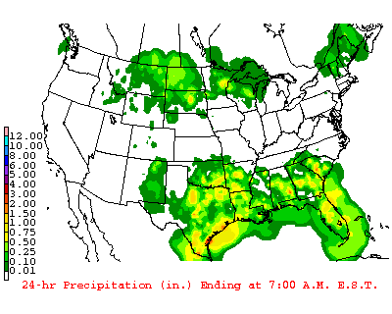
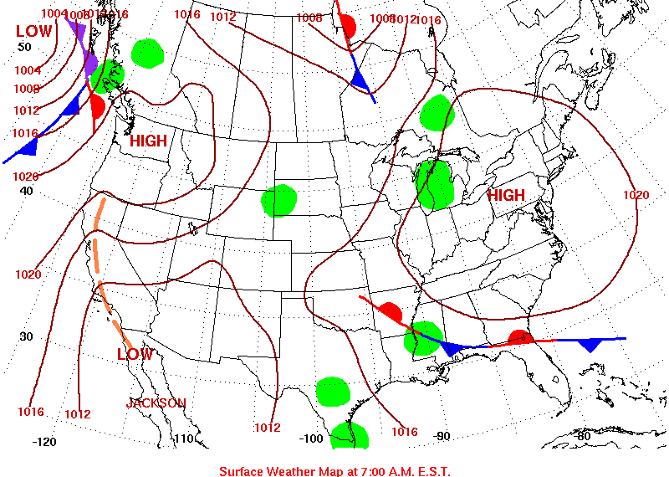
Possible Matches: June 26th – July 4th, 2007
July 3rd

Slide 27
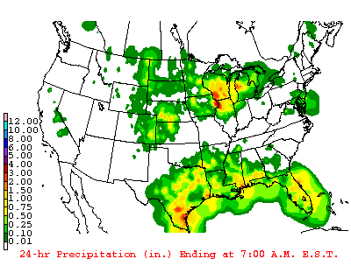
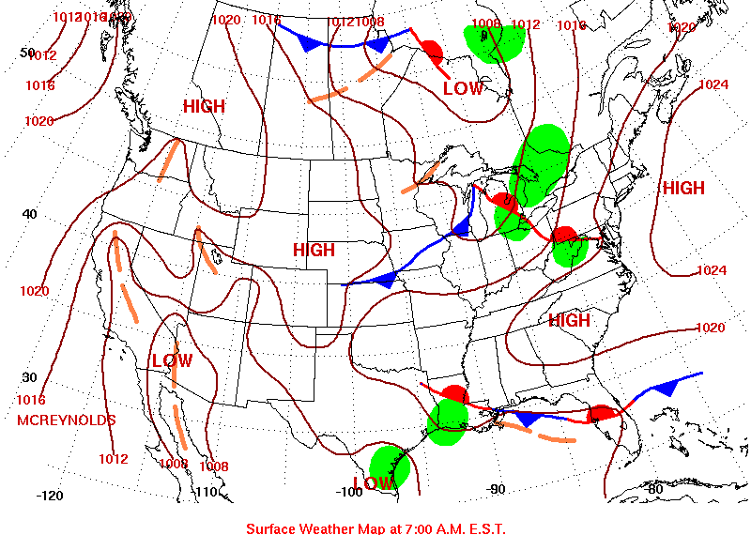
Possible Matches: June 26th – July 4th, 2007
July 4th

Slide 28
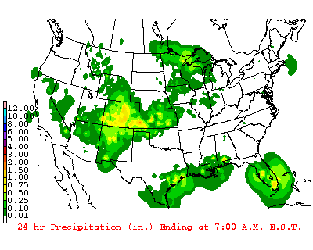
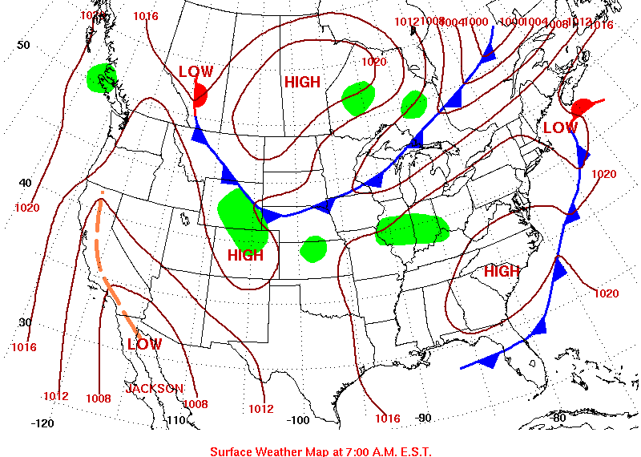
Possible Matches: July 9th – 14th, 2006
July 9th

Slide 29
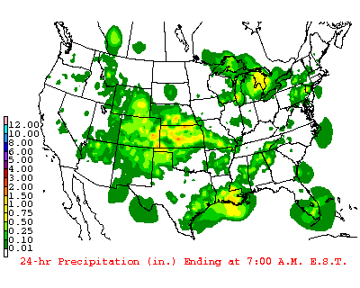
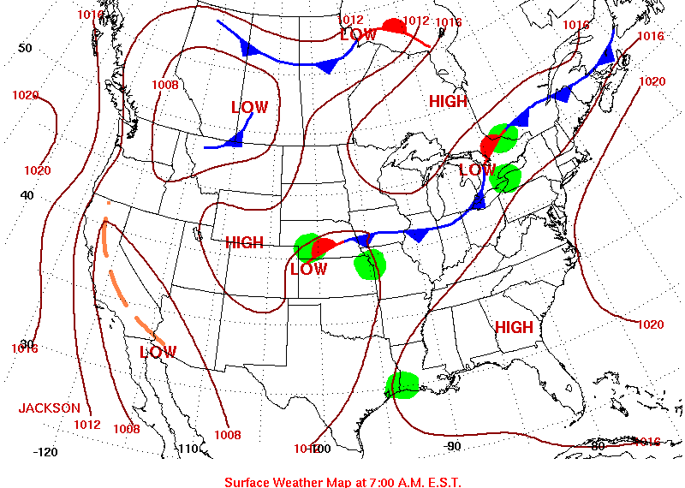
Possible Matches: July 9th – 14th, 2006
July 10th

Slide 30
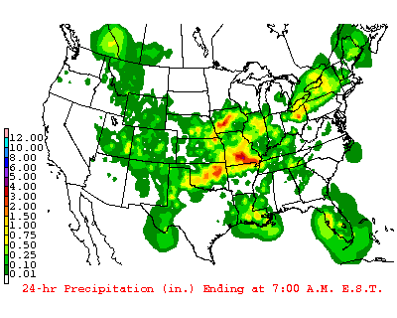
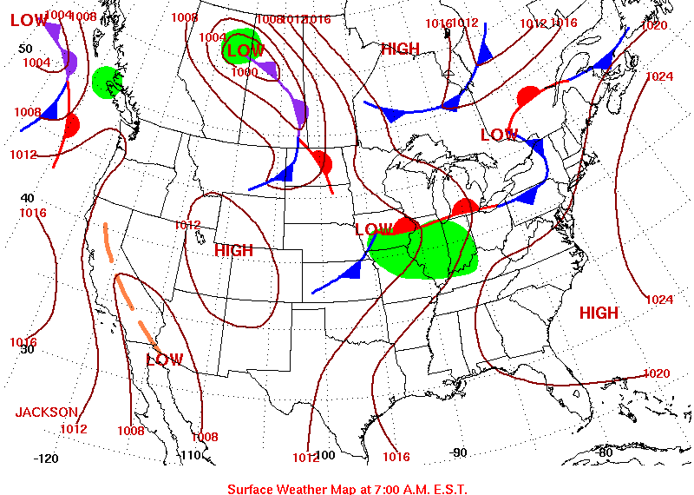
Possible Matches: July 9th – 14th, 2006
July 11th

Slide 31
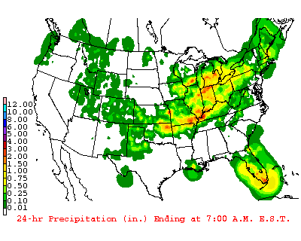
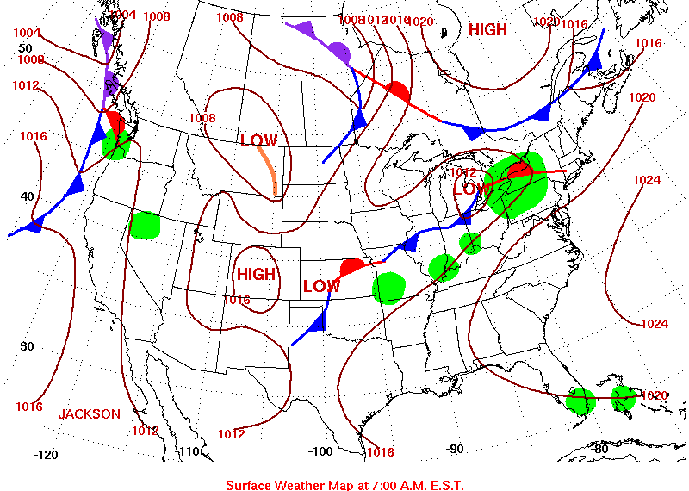
Possible Matches: July 9th – 14th, 2006
July 12th

Slide 32
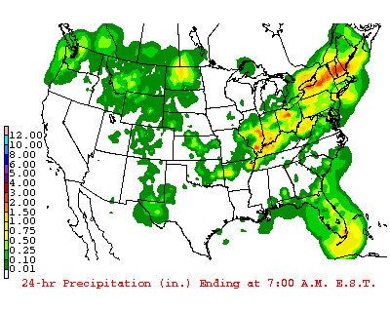
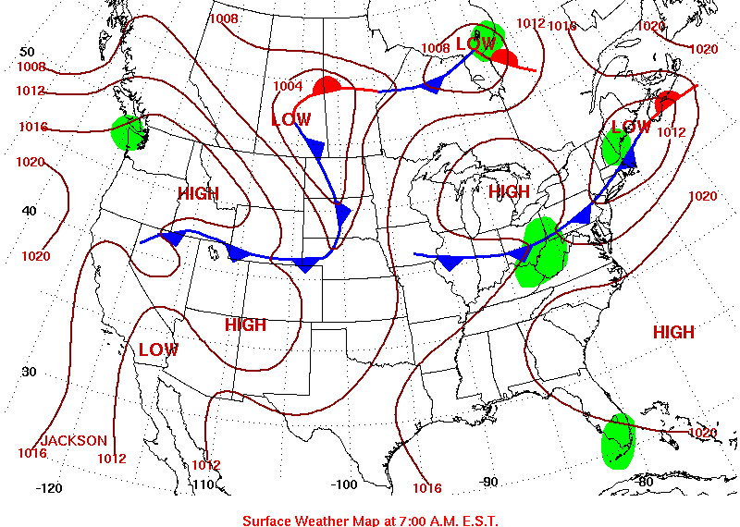
Possible Matches: July 9th – 14th, 2006
July 13th

Slide 33
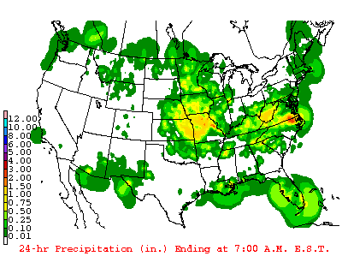
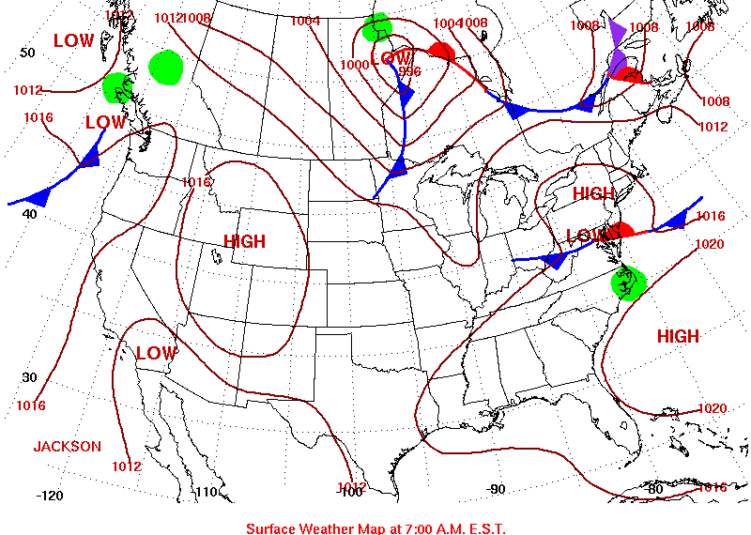
Possible Matches: July 9th – 14th, 2006
July 14th

Slide 34
Additional Info
These models were consistent with a classic La Niña weather pattern which occurs approximately every five years.
The year 1861 was “G-Type” La Nina SST’s from June to December of 2007.

Slide 35
Additional Info
Furthermore, these patterns tend to spawn more than the usual number of hurricanes in the Atlantic.
In 1861, there were 7 known hurricanes.
In 2007, there were 6 hurricanes.
We were able to create an analog suitable to the situations provided. We were especially able to find a great analog for Carthage, using data from 2007.

Slide 36
Additional Info.
An examination of the Battle of Lexington was more difficult as we had to drew in more information from around the country.
Transition season patterns are less persistent.
September 13 – 27, 2007 looks like a reasonable analog for conditions surrounding the week for the Battle of Lexington (Sept. 19 – 20, 1861).

Slide 37
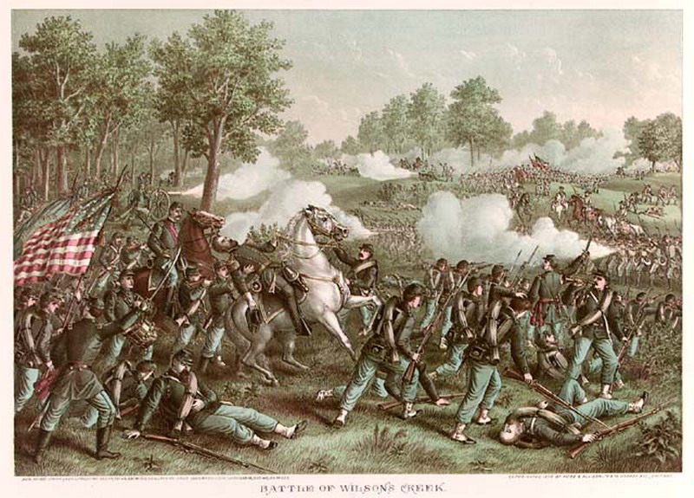
Battle of Wilson's Creek 1861: How weather may have influenced the outcome
James Michael Madden
John Thomas Moon III
Dr. Anthony R. Lupo

Slide 38
Introduction
This battle was one of the most significant conflicts in the Civil War. 1
Setting: Near Springfield, MO
“It is agreed that, while the Confederates won the battle, Lyon’s campaign saved Missouri for the Union.”2
Battle started around 5:00 AM.
Battle finished around 11:30 AM.
Original Battle Plans were delayed by a rain storm.
Holcombe, Ira. An account of the Battle of Wilson’s Creek, or Oak Hills… in Greene County, Missouri. Missouri: Dow and Adams, 1883.
Souvenir Edition of the Battle of Wilson’s Creek, August 10, 1861. 16 pages, illus. maps. Page 13.

Slide 39
The Rain
“I … issued orders on the 9th instant to my force to start at 9:00 at night to attack at 4 different points at daylight … When the time arrived for the night march, it began to rain slightly, and fearing from the want of cartridge boxes, that my ammunition would be ruined, I ordered the movement to be stopped, hoping to move the next morning.” 1
--- General McCulloch of the Confederate Forces
DELAY OF BATTLE DUE TO RAIN!
1. “Gen. McCulloch’s description of the Battle of Oak Hill [Wilson’s Creek]." The Liberty Tribune. Sept 20, 1861. Volume XVI.

Slide 40
The Rain
“The march was ordered for 9 o'clock, but there came a gentle rain which induced General McCulloch to countercommand the order to march and give orders for the soldiers to sleep on their arms.” 1
--- Nameless Confederate Soldier
1. “An Account of the Battle [of Wilson’s Creek] by a confederate soldier.” The People’s Tribune. Jefferson City, MO. August 20, 1873. Vol 8. No. 35.

Slide 41
The Rain
“Three hours later – at midnight – the drizzle swept across General Lyon’s Army but a few miles away as it marched, silently and methodically, toward preselected positions overlooking the Confederate Camp.” 1
1. Souvenir Edition of the Battle of Wilson’s Creek, August 10, 1861. 16 pages, illus. maps. Page 2.

Slide 42
Without the Rain?
We can definitely say that the outcome could have been different.
The rain delayed the CONFEDERATE attack. It allowed for the Union forces to methodically move toward safe positions overlooking the confederate camp.1
It also allowed for the Union forces to have a chance to strike first. (1st Strike: Union Forces: around 5:00 AM)
Therefore, the Union forces were helped by the rain.
Souvenir Edition of the Battle of Wilson’s Creek, August 10, 1861. 16 pages, illus. maps. Page 2.

Slide 43
Conditions
We deduced the weather based on soldier comments.
Rain fell for approximately three hours the previous night.
Humid
Warm to Hot (morning temperatures in the low to mid-70s F, and highs in the mid 80s to low 90s F in regions north and west).
http://www.djburnette.com/research/kansas/index.html

Slide 44
Procedure
We would establish climatological norms for that time of year.
The norms are not likely to have changed significantly since 1861.
A warm July/August Day would be in the low 90s.
We then examined the days in which the temperatures were in the low 90s.
0.25-0.5 inches of rain fell during late July and early August in SGF.
We looked at the surface and upper air features and came up with one 500 hPa mode, and two possibilities for the surface map.

Slide 45
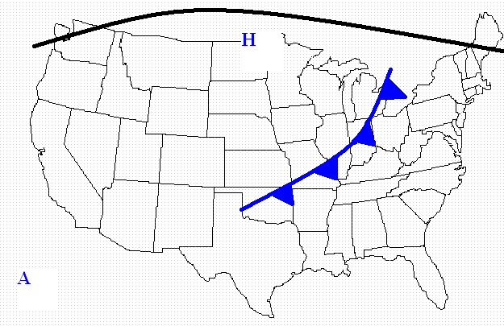
One Possibility

Slide 46
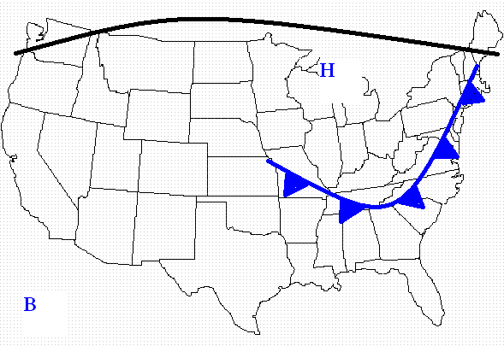
The Other Possibility

Slide 47
Let’s Use Some Climatological Models
Light rain may have been the result of weak cold frontal passage.
The Upper Air pattern was likely dominated by a ridge (an elongated axis of high pressure) across the northern tier of states and whose axis was located over the plains.

Slide 48
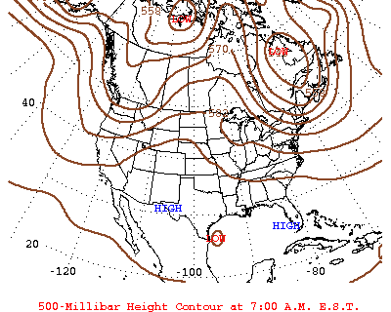
August 11, 2006

Slide 49
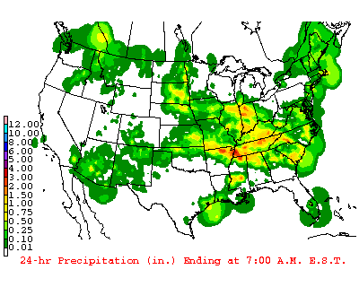
August 11, 2006 RADAR

Slide 50
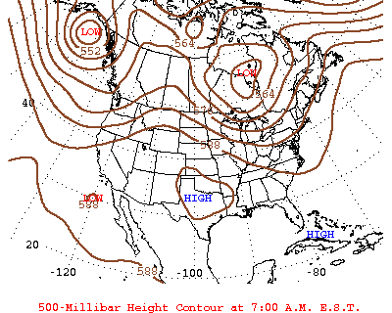
July 26, 2008

Slide 51
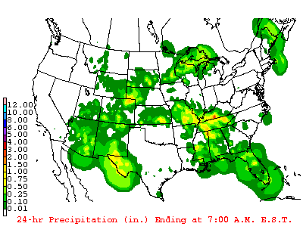
July 26, 2008 RADAR

Slide 52
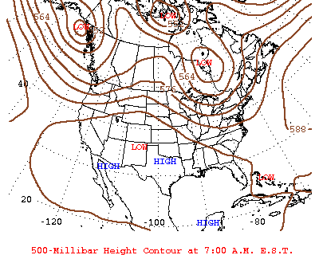
July 27, 2008

Slide 53
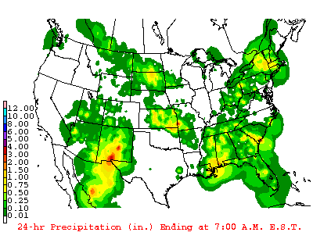
July 27, 2008 RADAR

Slide 54
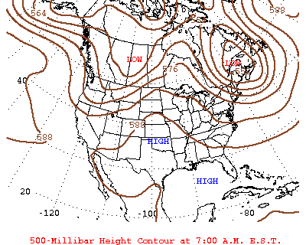
August 12, 2006

Slide 55
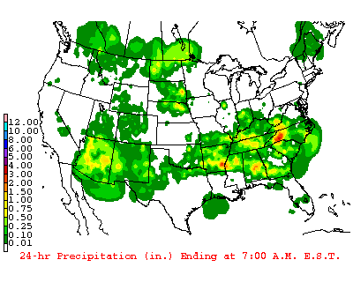
August 12, 2006 RADAR

Slide 56
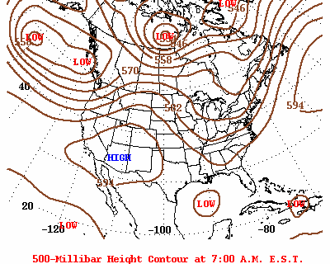
July 13, 2003

Slide 57
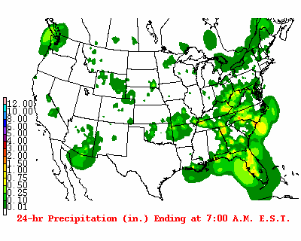
July 13, 2003 RADAR

Slide 58
Summary and Conclusion
Weather played a role in the outcome of the battle.
Without the rain, General McCulloch would have resumed the march towards Union forces at 9 0’clock the night before.
We can use current climatological data from the past several years to determine weather events from long ago, based on reports from newspapers, diaries, etc…
Thus, we can better determine how weather plays a role in significant historical events.

Slide 59
Summary and Conclusion
Weather is understudied when examining historical events.
Weather has significant roles in history.

Slide 60
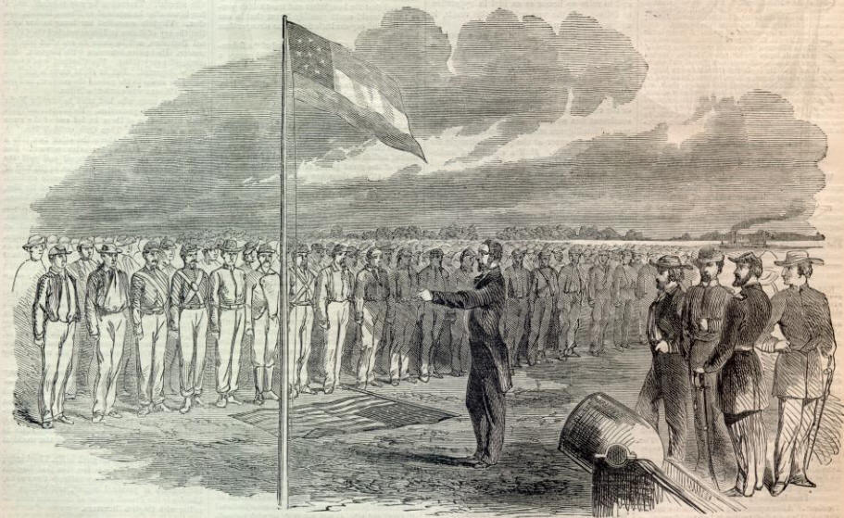
The First Battle of Lexington, September 1861: What was the role of weather?
Anthony R. Lupo
And
James Michael Madden

Slide 61
Introduction
Pictured on the front page is the address of ex-Governor Claiborne Jackson to surrendered Union Troops (sketched by O.R. and taken from Harper’s Weekly).
The first Battle of Lexington is often called the “battle of the hemp bales”, it occurred from 13-20 September and resulted in a confederate victory.

Slide 62
Introduction
The belligerents were the US Army (3,500 troops) led by Col. Robert Mulligan, and the Missouri State Guard under Maj. Gen. Sterling Price (a pro-confederate force of 12,500).
In the final assault of September 20, pro-confederates used hemp bales soaked in the Missouri river as shields to absorb Union artillery and arms fire.

Slide 63
Introduction
This allowed the pro-confederate force to get close enough to union positions to finally over-run them.
Clearly, weather was influential in the Carthage and Wilson’s Creek engagements. How influential was it for Lexington?

Slide 64
Methods
For this battle, unlike the other two, the weather was no longer in a summer regime. This makes reconstruction more difficult.
Summer patterns over North America show much less variation, which made reconstruction fairly simple.

Slide 65
Methods
As in the other two cases, descriptions from those who were there are best to use.
Records from nearby stations in Kansas were used.
Also observations from Minnesota and the Eastern United States were used.

Slide 66
Descriptions of the weather
From the Lexington Intelligencer March 8, 1902, the Lexington Letters:
W.S. Hyde(Monday Sept. 16, 1861): “It rained all day Saturday….. It is raining again this morning.”
(Wed. Sept 25th) “We need some more blanket and quilts.”

Slide 67
Descriptions of the weather
From anonymous on Sept. 22. 1861 printed in the Democratic Herald in Louisiana, MO:
“We lay in the trenches all of Thursday night, although it was raining hard, and some of us were without blankets.” – writer refers to Thursday Sept. 19th.

Slide 68
Descriptions of the Weather
The first hand accounts suggest a wet period of weather, and at least two to three heavy rains between September 13-20.
Wet weather may have led to a delay in the battle, but would definitely have helped the confederate forces keep the hemp bales wet (ample river water and no drying!).

Slide 69
Descriptions from outside MO
From Minnesota, September was cold during the 6th and 7th, but very hot and humid during the 14 – 19 th.
From Kentucky: Sept 16th Paducah, 70 F in the morning and 85 in the afternoon.
From Philadelphia, rain on the 19th.

Slide 70
Descriptions from outside MO
From Washington DC: The 14th to the 18th was sunny and pleasant, and was likely associated with high pressure.
During the 18th to the 22nd it was warm and humid. This suggests strong southerly flow and a departing high.

Slide 71
Actual Data
The average high during this time of year today 78 F, and 54-55 F for lows.
In 1861, this would be similar 75 – 78 F for a maximum and 52 – 55 F for minima.
Actual readings come from Kansas.

Slide 72
Actual Data
Leavenworth, KS
Date Min Max
Sept 13 63 F 75F
Sept 14 71 F 88 F (Frontal passage - cold)
Sept 15 69 F 71 F
Sept 16 63 F 76 F (Frontal passage - warm)
Sept 17 64 F 87 F
Sept 18 74 F 90 F
Sept 19 75 F 92 F (Frontal Passage - cold)
Sept 20 56 F 64 F
http://www.djburnette.com/research/kansas/index.html

Slide 73
Actual Data
There were three frontal passages and the temperatures were quite warm for the time of year.
The morning of the final push was very much cooler, and a cold front had come through.
The summer regime finally seems over at this point.

Slide 74
Actual Data
The data suggests quite meridional flow, cool in early September, and a strong ridge during the week of the battle.
This is typical of a La Nina year. Warm weather late into the year. An active Atlantic hurricane year (1861), and a La Nina – like sea surface temperatures in the Pacific.

Slide 75
The maps
We examined weather maps from the early to mid fall from 2000 – 2010.
The year 2007 was a La Nina like year, and the period from September 13 – 27 resembles the type of weather that would result in the descriptions above from inside and outside Missouri.

Slide 76
The maps
You can view these maps at:
http://www.hpc.ncep.noaa.gov/dailywxmap/index_20070913.html

Slide 77
Summary and Conclusions
The weather of Mid-September 1861 was discerned from first hand sources at the Battle of Lexington.
We examined data from stations relatively close to the battle site.
We also examined accounts from outside Missouri.

Slide 78
Summary and Conclusions
Mid-September 1861 was quite a bit warmer than normal. A large ridge was likely covering the eastern United States.
Three rain events were associated with temperature changes and likely may have delayed operations between September 13th and September 20th.
The morning of the final battle followed a heavy rain and likely thunderstorms as a cold front ushered in much cooler temperatures.

Slide 79
Summary and Conclusions
Reconstructing weather for the autumn was much more difficult than for summer because of the passage of fronts and changeable conditions.
Examining climate conditions, we determined 1861 must have been a La Nina year.

Slide 80
Summary and Conclusions
This rainy, wet period likely aided the pro-Confederate forces in using soaked hemp bales to defeat Union Forces.
Thus the weather played a prominent role in the strategy used by the pro-confederate forces and the outcome, similar to that of the role of weather in the Battles of Carthage and Wilson’s Creek.

Slide 81
Given the information that we have, we will propose what impacts that weather might have played and what might have been the outcomes if the weather was different.
What resources do you think would have been helpful to remedy the weather situations on the battles?
What do you think might happen next in the battles of the State?

